Slide 1
SEABORNE TRANSPORTATION OF FERTILIZERS, TRENDS & OUTLOOK.
PRESENTED BY:-
AMAN RAWAT
BAINBRIDGE NAVIGATION

Slide 2
CONTENTS
OVERVIEW OF FERTILIZER SECTOR.
FERTILIZER SUPPLY & SUPPLY CHAIN.
TOP FERTS EXPORTING COUNTRIES.
FERTS USAGE BY GRAINS SECTOR.
FERTS MKT IN 2020.
REASONS FOR PRESSURE ON FERTS PRICES.
PROJECTION OF 2021 FERTS MKT.
INDIAN GOVERNMENT’S PLAN FOR FERTILIZER SECTOR.

Slide 3
OVERVIEW OF FERTILIZER SECTOR
Fertilizers made world self reliant in food grain production.
Key ingredient.
Three primary nutrients.
N.P.K
Who’s involved..?
Who’s the boss..! Russia, India, USA..?

Slide 4
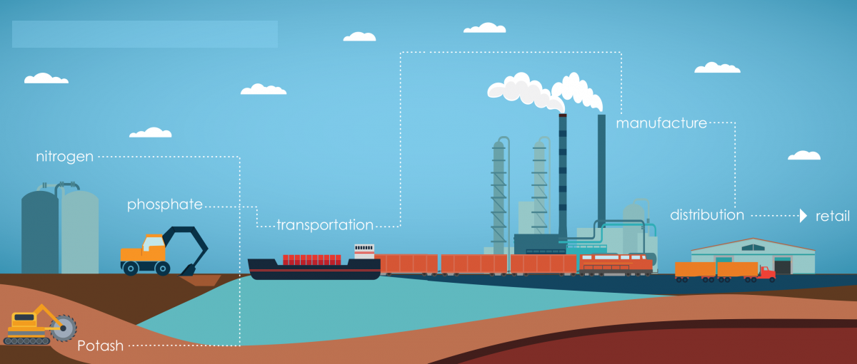
FERTILIZER SUPPLY CHAIN

Slide 5
FERTILIZER SUPPLY
Negative 2019 & 2020.
Lower Gas Prices in Europe & US adds positivity.
The global total nutrient capacity was 285.15 million tonnes in 2015, out of which the total supply was 245.77 million tonnes.
In year 2021 global capacity and production of fertilizers are expected to increase further.

Slide 6
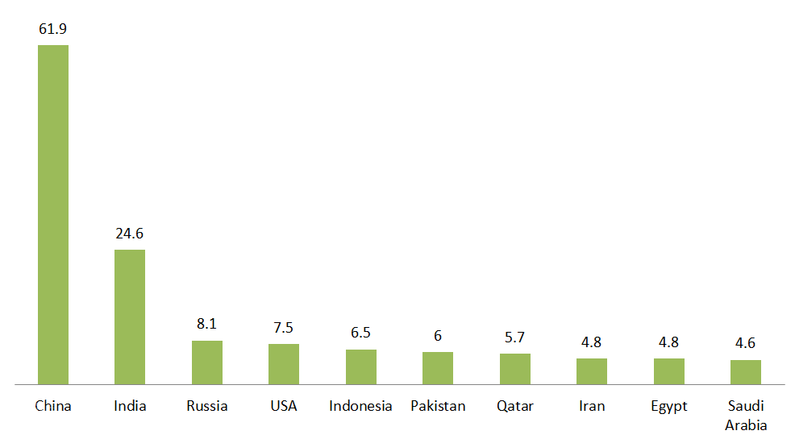
TOP FERTS EXPORTING COUNTRIES

Slide 7
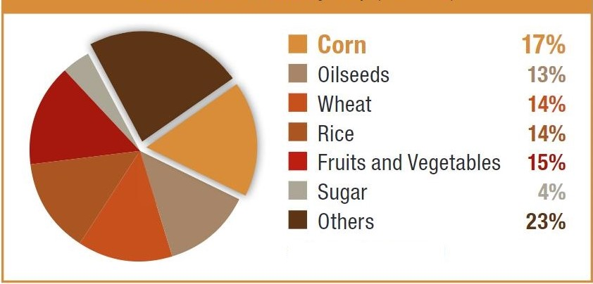
FERTILIZER USAGE BY GRAINS SECTOR

Slide 8
FERTILIZERS MARKET IN 2020
Reasonable high in 2018 & 2019, came under pressure in 2020.
Fertilizer prices lowest in a decade in 2020.
Buyers waited a “bottoming out” and pulled back orders.
Demand deferral results in downward momentum of pricing.
Anhydrous ammonia prices, for example, are currently around $500 per ton, but were closer to $600 per ton last year.
DAP prices have fallen the most, down 22%. All forms of nitrogen fertilizers were at least 10% lower.
DAP and potrash was highest in 2013 for $650-700/tn, and now its close to $500/ton.

Slide 9
REASONS FOR PRESSURE ON FERTS PRICES
1- UNITED STATES, A MAIN CULPRIT.
2- TRUNCATED SEASON
3- UKRAINE HIT RUSSIA WITH TRADE SANCTIONS.
4- SAUDI NPK EXPORTS DISAPPOINTED.
5- CHINESE NPK HAS LOW PRODUCT QUALITY AS Compared TO RUSSIA & UKRAINE.
6- NIGERIA BANNED N.P.K IMPORTS IN 2019.
7- removal of Chinese NPK export incentives.
8- ANTICIPATORY FALL IN 2019, AND COVID HELPED IT SUSTAINED.

Slide 10
PROJECTION OF 2021
Significant pent-up demand for fertilizers globally and the U.S.
Present fertilizer prices are very affordable which will attract demand.
Increased Chinese NPK Exports.
Ma’aden’s acquisition of Meridian.

Slide 11
PROJECTION OF 2021 – CONTI….
OCP’s expansion.
Increased Ethiopian Consumption.
Decoupling of Russia-Ukraine Trade Sanctions.
Russians focus on new markets.
Positive projection of world urea production.
More plantation planned across.

Slide 12
PROJECTION OF 2021 – CONTI….
China shall bounce back.
Rebounding US ferts applications.
India's increasing use of urea fertilizers.
Mixed opinion on U.S.A
South America pulling the demand.
Low gas prices may benefit ferts industry.

Slide 13
INDIAN GOVT’S PLANS FOR FERTS
Close monitoring the production and distribution of fertilizers.
New team & a road map.
DoF has advised all the fertilizer companies to ensure smooth movement of soil nutrients from plants and ports.
Additional storage of fertilizers in nearby plants.
Priority berthing of fertilizers vessels.

Slide 14
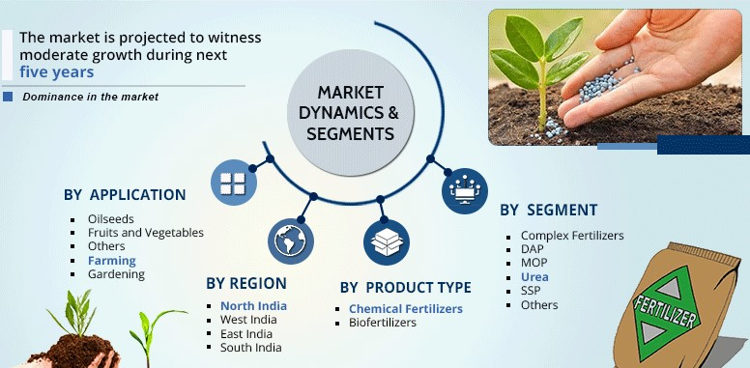
INDIAN FERTILIZER MARKET

Slide 15
UNANSWERED QUESTIONS
Decreasing world’s productive land size.
Will Ma’aden & other producers accelerate NPK production and where will it export?
How will Chinese NPK demand evolve?
Will India import more NPK in the future?
Scope of betterment of US-China trade relations..?

Slide 16

CONCLUSION

Slide 17
THANK YOU

